Slide 1
HRI - How embodiment impacts the perception of a system's weaknesses in understanding accents.
By - Travis Clauson, Kyu Rae Kim, Srisharan Kolige and Pierrick Lorang

Slide 2
Why did you pick your project?
AI can struggle to understand some of our accents
We wanted to understand how this frustration we feel is affected by anthropomorphism
To be relevant to HRI, we compare results between interactions with disembodied and embodied agents

Slide 3
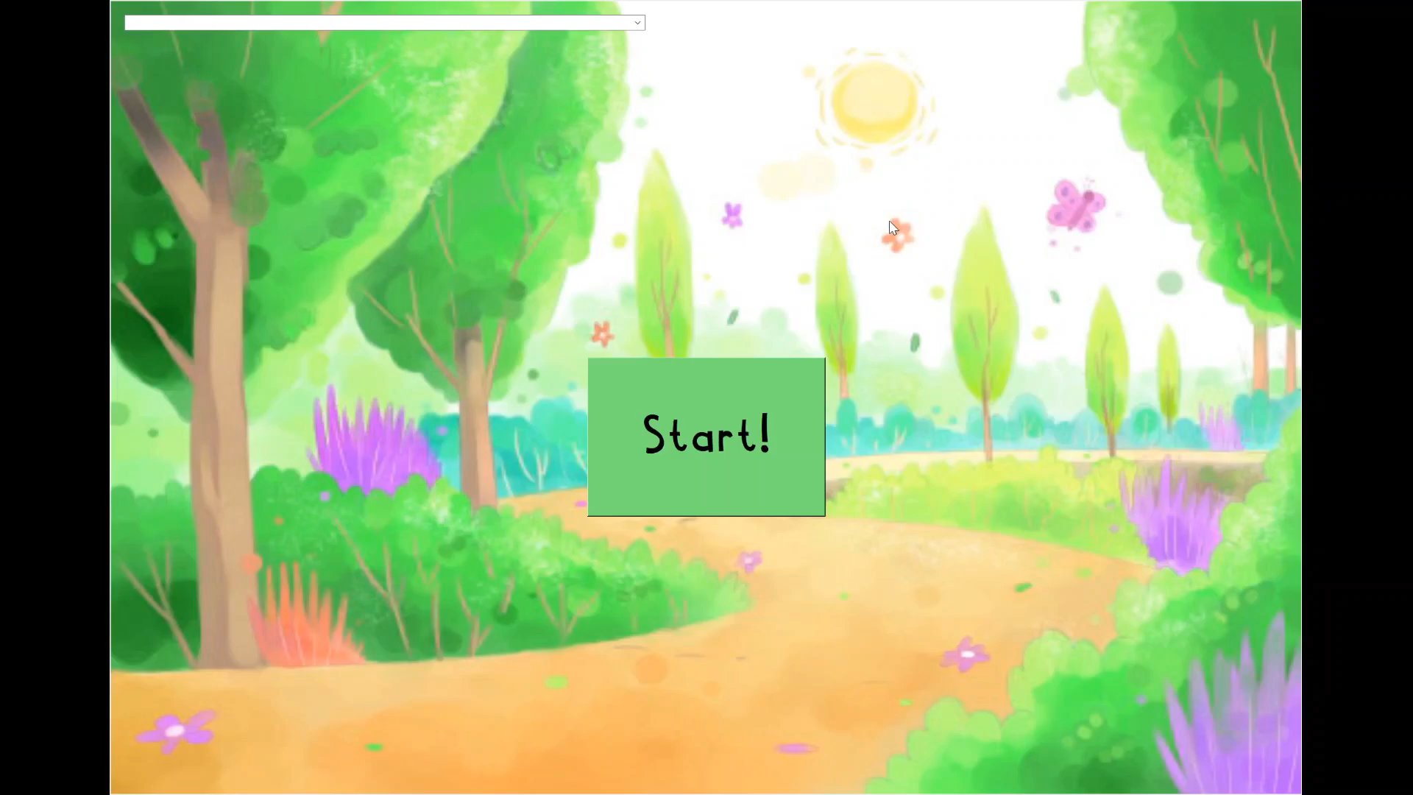
What did you do? What did you get the robot (or simulator to do)?
Project Video

Slide 4
How well did everything work?
We were able to get Misty to move and behave as desired (most of the time)
Our selection of words was great
The non-native english speakers found it hard to complete the task as the NLP was not developed enough to understand the different English accents.
We had a balanced group of participants: 10 native and non-native english speakers.
The results lined up with past work and our hypothesis

Slide 5
What would you do differently if you were going to do it again?
Misty is not fully developed and still has some bugs in it, we would have definitely saved a lot of time if we would have selected a better robot
If we gathered more participants, we could have compared results between accents from different parts of the world
We would have done a more thorough literature review to understand the current research trend and made our study more relevant to it.

Slide 6
What was the most interesting thing you learned from your project?
People have higher expectations from an anthropomorphic robot rather than disembodied AI
Existing NLPs (including Google, Siri or Alexa) are less competent at deciphering accents, more accurate with native speakers than we thought
Participants are much more likely to blame embodied AI for errors

Slide 7
What suggestions would you have for future COMP 133 students who are designing their projects?
Data analysis takes longer than you think
The contribution to the field does not need to be massive
The scope can be quite narrow, as long as it answers a relevant topic in HRI
Use Professor Short to help you define your study, she has done this a few times

